Slide 1
File System

Slide 2
Common Boot Sector Signatures by File System
File System | Hex Signature (Start Bytes) | ASCII Interpretation | Notes
FAT12 / FAT16 | EB 3C 90 4D 53 44 4F 53 35 2E 30 | “MSDOS5.0” | Classic DOS FAT; used on older USBs or small partitions.
FAT32 | EB 58 90 4D 53 57 49 4E 34 2E 31 | “MSWIN4.1” | FAT32 boot sector often shows “MSWIN4.1” or “MSDOS5.0”.
exFAT | EB 76 90 45 58 46 41 54 20 20 20 | “EXFAT” | The official signature for exFAT; easy to spot in hex.
NTFS | EB 52 90 4E 54 46 53 20 20 20 20 | “NTFS” | Signature you mentioned; starts with jump instruction + label.
EXT2 / EXT3 / EXT4 | No fixed start bytes (look for magic number at offset 0x438 = 53 EF) | — | Linux EXT family stores magic number deeper in the superblock, not at start.
HFS+ (macOS) | 48 2B AF 00 (at offset 1024) | — | HFS+ header appears after a 1024-byte boot block.
APFS (macOS) | 41 50 46 53 | “APFS” | Appears near offset 0 of the container superblock.
ReFS (Windows) | 52 65 46 53 | “ReFS” | Microsoft Resilient File System; seen in Windows Server versions.

Slide 3
The FAT File System

Slide 4
Think of the FAT as a big list (table)
Each row (or “entry”) in that list represents one cluster on the disk.
That entry stores:
  “What’s the next cluster in this file?”
  or
  “Is this the end of the file?”
  or
  “Is this cluster free/bad?”

Slide 5
In simpler terms
FAT version | Bits per entry | Meaning
FAT12 | 12 bits | Can describe up to ~4,000 clusters
FAT16 | 16 bits | Can describe up to ~65,000 clusters
FAT32 | 32 bits (really 28 used) | Can describe millions of clusters
So “32-bit” means the system uses 32 binary digits to store information about each cluster’s state and link (the “next cluster number” or “end of file” marker).

Slide 6
File system that was created in 1977
An old file system that still finds regular use today
The file system was named for its main organisational unit, which is also called the File Allocation Table (FAT).
The original version of the FAT file system was developed for floppy disks in 1977.
Since this time there have been three major versions of FAT: FAT12, FAT16 and FAT32.
The versions differ mainly in the size of addressable space available.
FAT was the traditional Windows file system before the advent of NTFS
Traditionally FAT filenames were in the 8.3 format - an eight-letter filename, followed by a three-letter extension

Slide 7
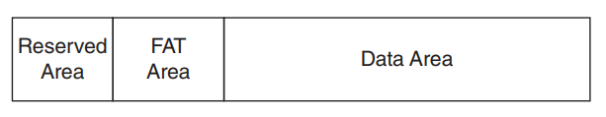
On-Disk Structures
All data in the FAT file system is stored in little-endian format
The reserved area contains file system information (FSINFO)
In FAT12 and FAT16 this area generally occupies only a single sector
In FAT32 this area contains more information and consequently is always larger.
The layout of the FAT file system.
Notes:
Little endian – the smallest piece of data (the least significant byte) is stored first in memory.
Lets take: 0x12345678
Each pair of digits (12, 34, 56, 78) is one byte.
How its store in little-endian: 78 56 34 12

Slide 8
Layout
The reserved area in all variants of FAT contains a volume boot record (VBR) in sector 0
In FAT32 this is generally followed by a FSINFO structure
FAT32 also often contains a backup of these structures. This means that the FAT32 reserved area is generally much larger than that of FAT12 and FAT16.
The FAT tables allow the file content to be recovered from disk and also allow empty clusters to be identified when allocating space for new files .
The final area of the FAT file system is that of the data area.
Notes:
Traditionally (i.e. FAT12 and FAT16) the beginning of the data area always contains the root directory structure from which the contents of the entire file system can be listed. In FAT32 the root directory is no longer guaranteed to appear at the very beginning of the data area; instead, it can be found anywhere inside the data area. Its location is found in the VBR (although it is still commonly found at the beginning of the data area).
-- Volume boot record: This book is written in FAT32 format, chapters start at page X, and here’s how to find them.

Slide 9
Volume Boot Record (reserved area)
This structure contains information about the file system as a whole.
The Sleuth Kit tool, fsstat, extensively consults this structure in order to gather information about the file system.
Processing the VBR allows all other structures to be located. For instance the FSINFO structure and the VBR backup are located directly from the primary VBR.

Slide 10
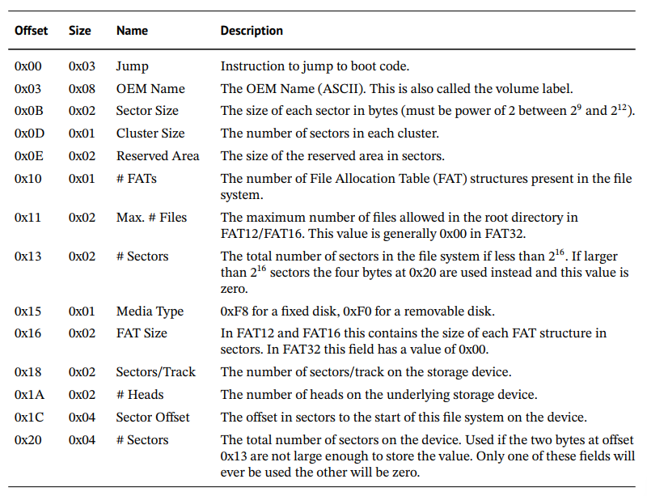
Notes:
the first 36d bytes in the VBR which are common to all FAT file system variants

Slide 11
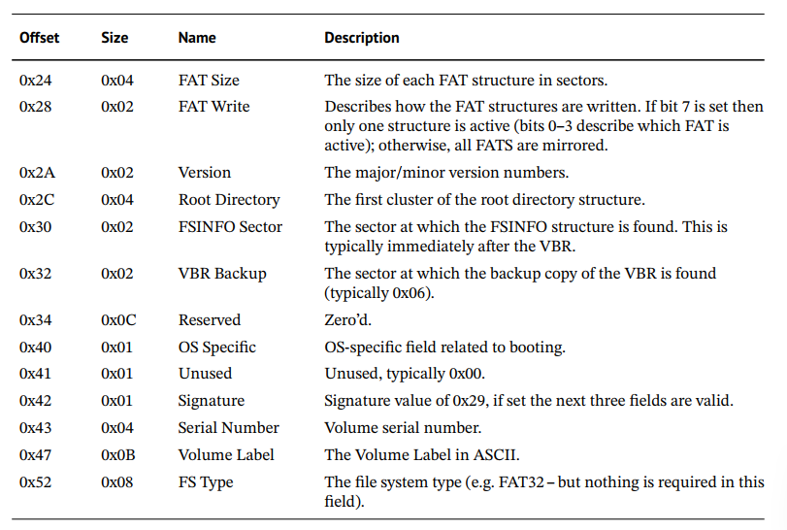
Notes:
contains information about the subsequent bytes in the structure as found in a FAT32 volume
The bytes at offset 510d and 511d (i.e. the final two bytes in sector 0) must always have the values 0x55 and 0xAA, respectively.
This is identical to the final two bytes in the master boot record (MBR) sector.

Slide 12
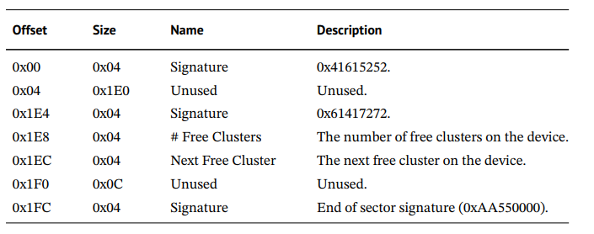
File System Information (FSINFO)
The FSINFO structure is an optional structure in FAT32, the location of which is found in the VBR itself.
This structure is used to optimise space allocation for new files.
As its purpose is space allocation the information contained in this structure is mainly related to free clusters on the device.
From a file system forensics perspective the FSINFO structure is not of vital importance.

Slide 13
File Allocation Table
serves two purposes
  acts as an allocation bitmap (although it uses more than a single bit per cluster) to allow efficient discovery of a cluster’s allocation status.
  allows the next allocated cluster in a file/directory to be located.
The starting cluster of a file/directory is located in the directory entry (next section) while subsequent clusters are found in the FAT structures.
Due to its importance there are typically two FAT structures present in most FAT file systems (although this should always be confirmed in the VBR).
Each cluster is represented by one entry in the FAT table.
The size of each entry is dependent on the version of FAT being used. In the FAT12 file system, 12 bits are used for each entry; in FAT16, 16 bits are used; and in FAT32, 32 bits are being used.
Notes:
The name of the file system variant is actually derived from the number of bits used to represent a cluster in the FAT table.
The File Allocation Table is like a map or index that helps the computer keep track of where every piece of a file is stored on the disk.
Think of your disk as a big notebook divided into pages (clusters).
When you save a file, it might not fit on one page -- it could be spread across many.
The FAT works like a table of contents that says:
“Page 1 of this file is here, the next part is on Page 7, then Page 12 and so on…”
So, the computer uses the FAT to follow the chain of clusters and read your file in the right order.
How FAT is important
Shows which clusters are free or used — like marking empty or filled pages.
Shows where the next cluster of a file is located — helping the system follow the file’s trail across the disk.

Slide 14
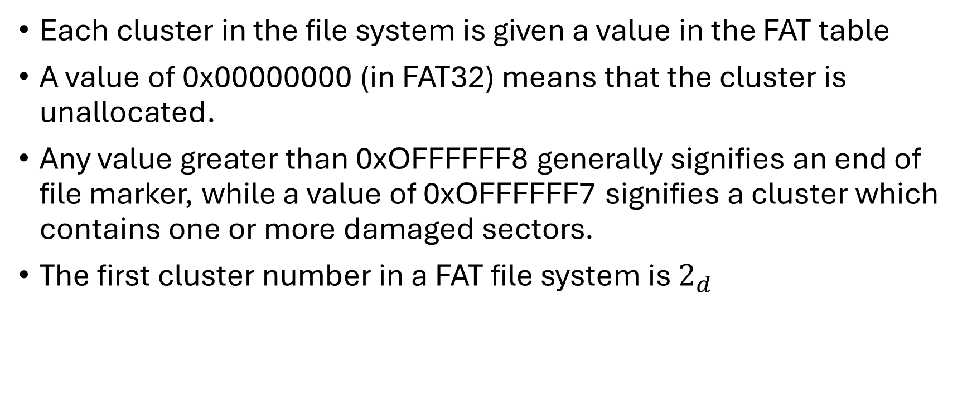
Each cluster in the file system is given a value in the FAT table
A value of 0x00000000 (in FAT32) means that the cluster is unallocated.
Any value greater than 0xOFFFFFF8 generally signifies an end of file marker, while a value of 0xOFFFFFF7 signifies a cluster which contains one or more damaged sectors.
The first cluster number in a FAT file system is $2_{d}$
Notes:
Imagine your disk as a big cupboard, and each shelf is divided into tiny boxes — those boxes are clusters.
Each cluster holds a piece of a file.
A file may need many clusters if it’s big.
If a file is very small, it still uses one full cluster, even if part of it is empty.

Slide 15
FAT Entry Value (Hex) | What It Means | Easy Explanation
0x00000000 | Unallocated cluster | The box is empty — no data stored yet.
0x0FFFFFF7 | Bad cluster | The box is damaged — can’t be used.
0x0FFFFFF8 to 0x0FFFFFFF | End of file (EOF) | The box is the last piece of a file — there’s no next part.
2 and onward | Valid data clusters | These boxes hold real file data and point to the next cluster in the chain.

Slide 16

Consider a file that occupies three clusters in the file system (clusters 3, 6 and 4).
The three clusters of interest are underlined. In order to recover the file content the starting cluster is first determined to be 3d from the Directory Entry
The entry for cluster 3d in the FAT table is then consulted. The value at this location is 0x06. This means that the next cluster in the chain is Cluster 6d.
Consulting this position in the FAT shows that the next cluster in the file’s content is 4 d. When the entry for cluster 4d is examined the end of file marker (0x0FFFFFFF) is discovered. This signifies the end of the FAT chain. Combining this information shows that the file’s contents occupy clusters 3, 6 and 4.
Sample FAT32 FAT table showing a file stored in clusters 3, 6 and 4.
Notes:
Each entry in the table corresponds to one cluster and tells the computer what comes next in that file’s chain of clusters.
Let’s explain step by step:
Start from cluster 3
The directory entry (the file’s record) says the file begins at cluster 3.
Check the FAT entry for cluster 3
In the FAT, the entry for cluster 3 has the value 0x06.
👉 This means: “After cluster 3, go to cluster 6.”
Check the FAT entry for cluster 6
The FAT entry for cluster 6 says 0x04.
👉 That means: “After cluster 6, go to cluster 4.”
Check the FAT entry for cluster 4
The FAT entry for cluster 4 contains 0x0FFFFFFF.
👉 That’s the End of File marker (EOF) — the file ends here.
So the sequence of clusters is: 3 → 6 → 4 → [EOF]
Imagine a book (the file) whose pages are scattered all over a shelf (the disk).
The FAT table acts like sticky notes that say:
“Start reading at page 3.”
“At the end of page 3, go to page 6.”
“At the end of page 6, go to page 4.”
“At the end of page 4 — stop, you’ve finished!”
That’s how the system knows how to put the file back together.

Slide 17
Directory Entries
Directories in the FAT file system are merely normal files which contain a sequence of directory entries as content.
A directory entry is a 32d metadata associated byte structure that contains the file’s name and all with the file.
It allows the files on the volume to be listed, file metadata to be gathered and file content to be recovered.
two types of directory entry that are used in FAT
  the structure of the generic directory entry -- allowing only for 8.3 filenames
  LFN directory entry -- filename length greater than the traditional 8.3 format
Type | Description
Standard (8.3 format) | Old-style entry — file names can have up to 8 characters for the name and 3 for the extension (like REPORT.TXT).
LFN (Long File Name) | Used when a file name is longer than the 8.3 limit (like MyVacationPhotos2025.jpg). The long name is broken into multiple entries, each storing part of the name.
Notes:
There are some points to note about the FAT directory entry structure.
Firstly, 32d bytes is not much space in which to store very detailed information about a file.
If you compare the output of Sleuth Kit’s istat command when run on a FAT file system to a more modern and complex file system you will see a large difference in the volume of reported information.
Listing 5.2 shows an example of this with the output from both FAT32 and ext4 file systems.
It is clear that ext4 contains more metadata information than FAT. There are four timestamps for instance and not just three that are found in FAT.
Ext4 also provides a generation ID, UID, GID, mode and number of links, none of which FAT provides.

Slide 18
Directory Entries (Where They Are Located)
Root Directory Area (for FAT12/FAT16)
  In FAT12 and FAT16, the root directory is stored right after the FAT tables.
  It has a fixed size defined in the Volume Boot Record (VBR).
  Example layout:
  | Boot Sector | FAT | Root Directory | Data Area |
Data Area (for FAT32)
  In FAT32, the root directory is just another normal directory stored in the data area, the same place as other folders and files.
  It starts at a specific cluster (the starting cluster is listed in the VBR, often cluster 2).

Slide 19
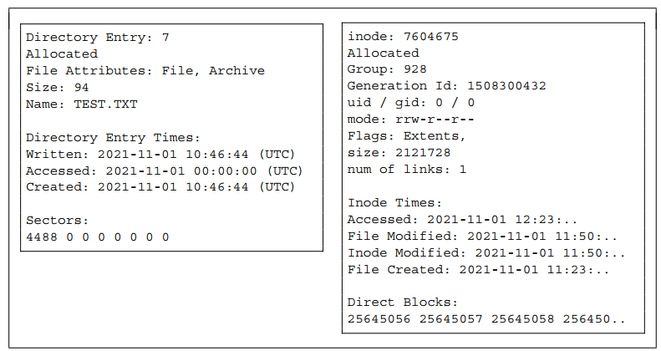
Notes:
Differences in istat output between different file systems. The output on the left is from the FAT file system, while the right is from ext4 (Chapter 9). Note the ext4 timestamps have been truncated
== There is no access time structure in the FAT directory entry! Sleuth Kit (and many other tools) choose to display a value of 00:00:00, when in reality there is no value.

Slide 20
LFN directory entry allows for filenames longer than the traditional 8.3 scheme.
Generally the LFN entries are found in reverse order before the actual directory entry itself.
The sequence number is used to confirm the order of these entries. The sequence number of the last LFN for a file (generally the first directory entry to appear in the sequence of directory entries) is XOR’d with 0x40. Hence to get the actual value this must be reversed, i.e. XOR’d again with 0x40.

Slide 21
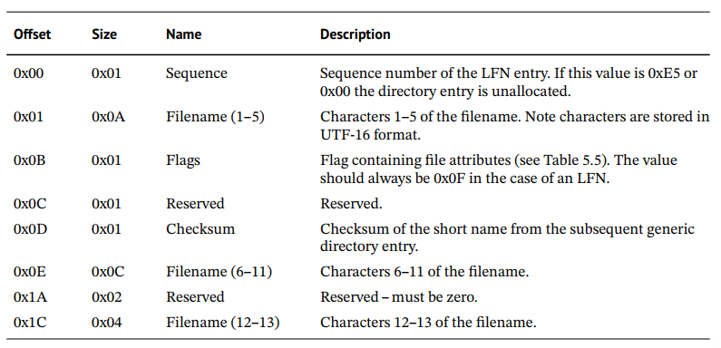
Notes:
The structure of an LFN entry is shown in Table 5.6.

Slide 22
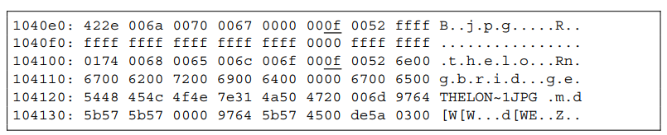
Three directory entries for a file with a long file name component. The first two entries are LFNs while the final entry is the generic directory entry
Notes:
In Listing 5.3 each of the LFN directory entries has a flag value of 0x0F (underlined). In each case the checksum value is 0xA0 showing the LFNs are most likely belonging to the same file (obviously with only a single byte checksum there is a large probability of collision occurring). The first byte in each of the entries represents the sequence. These bytes are 0x42 and 0x01. As stated previously the sequence byte in the first entry is XOR’d with 0x40 giving:
01000010 ⊕ 01000000 = 00000010 = 0x02
This result shows the first LFN entry is the last part of the filename, sequence number 2. The name components of each of the LFN directories can be combined to give: thelongbridge.jpg.
Listing 5.3 shows an example of a file with a LFN (this file is in the FAT32_V2.E01 disk image – see Section 5.2.2)
The 0x0F Flag
In your hex dump, you see values like 0x0F (underlined).
That’s the attribute flag field of an LFN entry.
It tells the system:
“This is not a normal file entry — this is part of a long filename.”
So every time FAT sees 0x0F, it knows the entry belongs to a long name rather than a normal 8.3 file.
The Checksum (0xA0)
Each LFN entry also stores a checksum of the 8.3 short filename entry that follows it.
This checksum is used to link all those LFN entries to the same short-name entry.
So if several LFN entries have the same checksum (like 0xA0 here), they all belong to the same file (e.g., Thelongbridge.jpg).
In a FAT directory, when a file has a long name (like Thelongbridge.jpg), the system also keeps a short version (like THELON~1JPG) for older software.
Imagine you have three puzzle pieces (The, long, bridge.jpg) — these are your LFN entries.
You also have the box cover that shows the whole picture (THELON~1JPG) — that’s your short name.
To make sure all those pieces belong to the same puzzle, you print the same code number (checksum) on each piece and the box.
In this example, that code is 0xA0.
Step Description Example Result 1 Take the short name (8.3) THELON~1JPG 2 Convert to ASCII bytes 54 48 45 4C 4F 4E 7E 31 4A 50 47 3 Run checksum algorithm Rotates + adds each byte 4 Final checksum 0xA0 5 Store in LFN entries Used to connect long and short names

Slide 23
8.3 name conversion
Filename: this_is_word
Extension: docx
The base name can only be 8 characters, and the extension only 3.
  Base name: this_is_word → take the first 6 characters → THIS_I
  (FAT uses the first 6 chars + ~1 to form 8 chars)
  Extension: docx → truncate to 3 → DOC
Combine and uppercase
Combine them → THIS_I~1.DOC

Slide 24
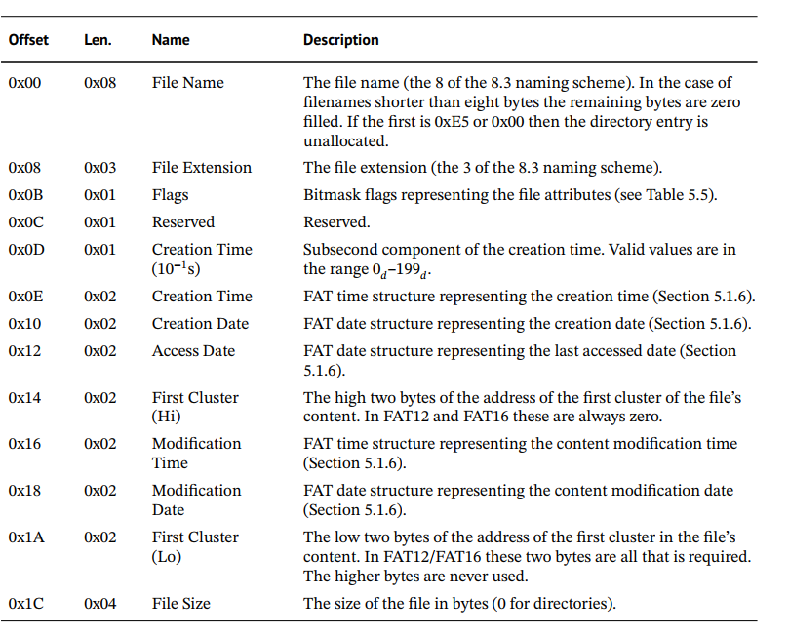
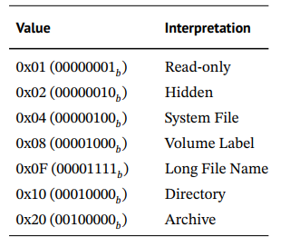
FAT generic directory entry structure.
Table 5.5
Notes:
shows the structure of the generic directory entry. However, this structure is limited in filename length, allowing only for 8.3 filenames. Hence there is a second type of directory entry called a LFN directory entry. This structure is shown in Table 5.6. It allows for filename length greater than the traditional 8.3 format.

Slide 25
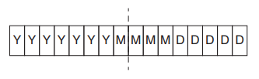
FAT Date and Time
epoch time values, in which time is implemented in a computer as a counter from a particular moment.
The FAT family of file systems is the only file system that does not use an epoch-based time system.
Instead FAT uses bit fields to store the date and time.
The FAT date is a two-byte structure which is divided into three separate components, year, month and day.
Notes:
the most significant seven bits are used to represent the year. This allows for 27 = 128d possible values.
Hence, FAT defines year 0 to be 1980. This means that 1980 must be added to this stored value to get the actual year. The next four bits represent the month and the final five bits represent the day.

Slide 26
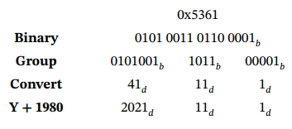
To demonstrate the FAT date consider a value of 0x5361. This value is converted as follows:
Notes:
Hence the FAT date 0x5361 is actually 1 November 2021. The FAT time uses the same method of storage
Hence the FAT date 0x5361 is actually 1 November 2021.

Slide 27
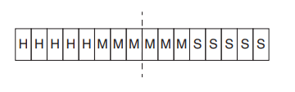
FAT time
The FAT time uses the same method of storage
Here the five most significant bits represent the hour while the next six bits represent minutes.
This leaves five bits to represent the seconds; however, this only provides 25 = 32 d possible values. As this is not sufficiently large to represent 60d seconds, the FAT time actually records seconds divided by two!

Slide 28
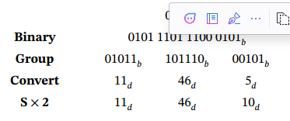
Consider a recovered FAT Time value of 0x5DC5.
Using the same method as shown for FAT date, this value is converted to a human-readable form.
Notes:
This results in a time value of 11:46:10 or 11:46:11.4 The FAT time value that is stored in file systems is stored as local time, in other words, in the computer’s timezone. This is unlike most modern file systems which generally store time as UTC

Slide 29
Mapping Cluster to Sector
Symbol | Meaning | In plain English
S# | Sector number | The physical sector on the disk where your cluster begins
C# | Cluster number | The cluster you want to find (e.g., cluster 5)
CSize | Cluster size | How many sectors are inside each cluster (from the boot sector)
RSize | Reserved area size | How many sectors are used by the reserved area (like boot records)
FAT# | Number of FATs | Usually 2 — means two copies of the FAT are stored
FATSize | Size of each FAT | How many sectors each FAT takes up

Slide 30
What a “cluster” and “sector” mean
  A sector is the smallest physical unit on a disk (usually 512 bytes)
  A cluster is a group of one or more sectors (for example, 8 sectors = 1 cluster)
So, when you want to find where Cluster 5 is physically stored, you need to figure out:
  “Which sector number on the disk does that cluster start at?”

Slide 31
The FAT file system divides the disk into areas:
  Reserved area — where the boot sector (VBR) and system info live
  FAT area — where the File Allocation Tables (maps of clusters) are stored
  Data area — where actual files and folders’ contents (clusters) are stored
The data area is where the real file content begins — that’s where clusters 2, 3, 4, etc. live.

Slide 32
Symbol | Meaning | Plain explanation
C# | Cluster number | The cluster you’re interested in (e.g., cluster 5).
CSize | Cluster size | How many sectors make up one cluster (from VBR).
RSize | Reserved area size | How many sectors are before the FAT area.
FAT# | Number of FAT copies | Usually 2 (FAT1 and FAT2).
FATSize | FAT size | How many sectors each FAT takes.
S# | Sector number | The result — which sector on the disk the cluster starts at.
Notes:
To find where a cluster really lives on the disk,
skip over the reserved sectors and FAT tables first,
then count forward based on how many clusters you’ve gone past.

Slide 33
Example:
Item | Value
C# | 5
CSize | 8 sectors per cluster
RSize | 32 sectors
FAT# | 2
FATSize | 128 sectors each
Notes:
S#=[(5−2)×8]+32+(2×128)
$$S\#=\left[3×8\right]+32+256=24+32+256=312$$
If each sector is 512 bytes, the byte offset would be:
$$312×512=159,744bytes$$
That’s where cluster 5’s data begins in the disk image.

Slide 34
Exercise
Represent the following dates/times as FAT date/time values.
a) 14:37:28 on 17 March 2023
b) 07:12:57 on 25 December 2077
c) 23:59:59 on 31 December 1999

Slide 35
Exercise
What dates/times are represented by the following FAT date/time values?
a) Date: 0x5199; Time: 0x4CBA
b) Date: 0x4885; Time: 0x1A3D
c) Date: 0x4934; Time: 0x432F

Slide 36
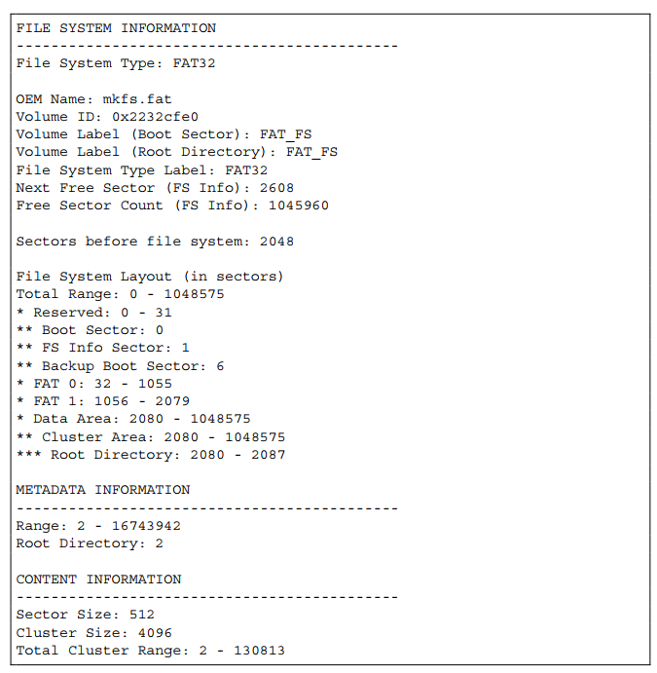
Analysis of FAT32
Process the VBR
Notes:
Sleuth Kit’s fsstat command

Slide 37
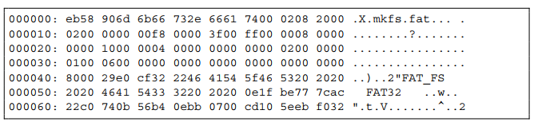
Excerpt from the VBR in FAT32_V1.E01
Notes:
bytes at 0x0B–0x0C are: 02 00
The FAT specification says the value is little-endian, so: 0x0002 → 0x0200
Converting 0x0200 to decimal = 512.
Little endian: The least significant byte comes first in memory or on disk.
We want to find Root Directory Cluster --- this.

Slide 38
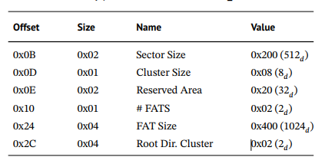

Slide 39
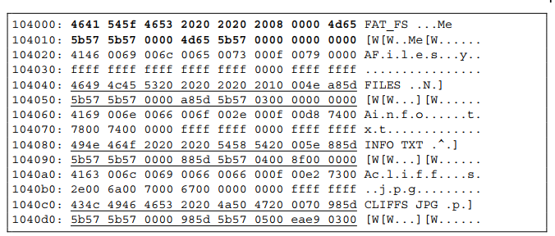
Root Directory

Slide 40
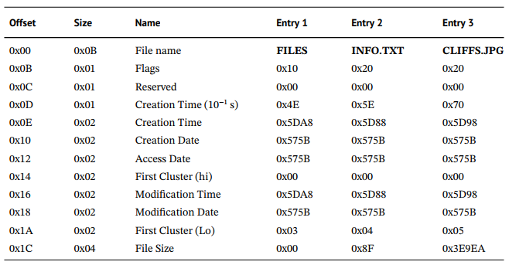
Processed generic root directory entries in FAT32_V1.E01.

Slide 41
Process Sub-directories
The next step in the analysis of the FAT file system is to process all the sub-directories.
Sub-directories are identical to the root directory in structure (except that they will not have a volume label entry).
Hence all sub-directories can be processed in the same manner as the root directory.
Once all sub-directories have been processed the listing of all files in the file system is complete.

Slide 42
Recover Metadata/Content
Consider the file INFO.TXT. The first cluster of this file is 0x04 (4d) and it is 0x8F (143d) bytes in size. Cluster 4d is found in sector number:
Notes:
S# = ((4 - 2) × 8) + 32 + (2 × 1024) = 2096d

Slide 43
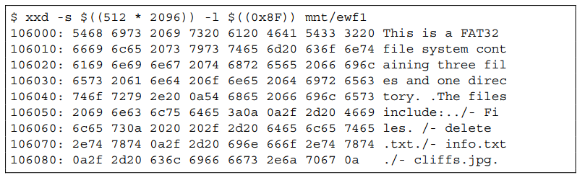
S# = ((4 - 2) × 8) + 32 + (2 × 1024) = 2096d

Slide 44
But what about a larger file?
INFO.TXT was only 143d bytes in size, much smaller than a single cluster.
What about a file such as CLIFFS.JPG which is 0x3E9EA (256, 490d) bytes beginning in cluster 0x05 (5d)?
As this is much larger than the cluster size (4096d bytes) multiple clusters must be used.
The directory entry provides only the first cluster. In this case the FAT table is consulted.

